Slide 1
CPSC3300: Computer Systems Organization
Lecture 8½ – Karnaugh Maps and Review / Outline of Topics for Exam 1

Slide 2

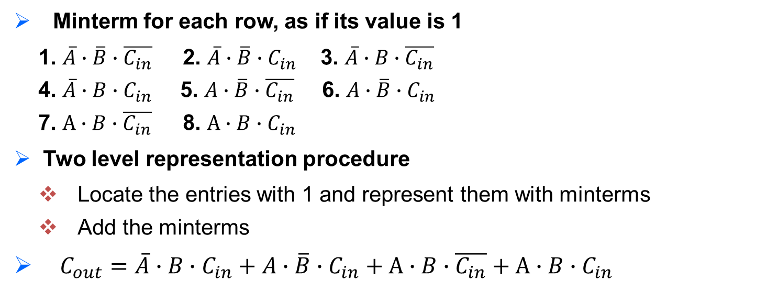
Logic Functions in Two-Level Representation
SoP can be used to determine the logic functions of variables
Example: identify the function for C_{out}
Given 3 variables A, B, C_{in}, #literals?
6 literals: A, B, C_{in}, $\overline{A}$, $\overline{B}$, $\overline{C_{in}}$
What are the minterms with three variables?
How to determine the function?
input |  |  | output
A | B | C_{in} | C_{out}
0 | 0 | 0 | 0
0 | 0 | 1 | 0
0 | 1 | 0 | 0
0 | 1 | 1 | 1
1 | 0 | 0 | 0
1 | 0 | 1 | 1
1 | 1 | 0 | 1
1 | 1 | 1 | 1
Minterm for each row, as if its value is 1
1. $\overline{A}∙\overline{B}∙\overline{C_{in}}$ 2. $\overline{A}∙\overline{B}∙C_{in}$ 3. $\overline{A}∙B∙\overline{C_{in}}$
4. $\overline{A}∙B∙C_{in}$5. $A∙\overline{B}∙\overline{C_{in}}$6. $A∙\overline{B}∙C_{in}$
7. $A∙B∙\overline{C_{in}}$ 8. $A∙B∙C_{in}$
Two level representation procedure
Locate the entries with 1 and represent them with minterms
Add the minterms
$C_{out}=\overline{A}∙B∙C_{in}+A∙\overline{B}∙C_{in}+A∙B∙\overline{C_{in}}+A∙B∙C_{in}$

Slide 3
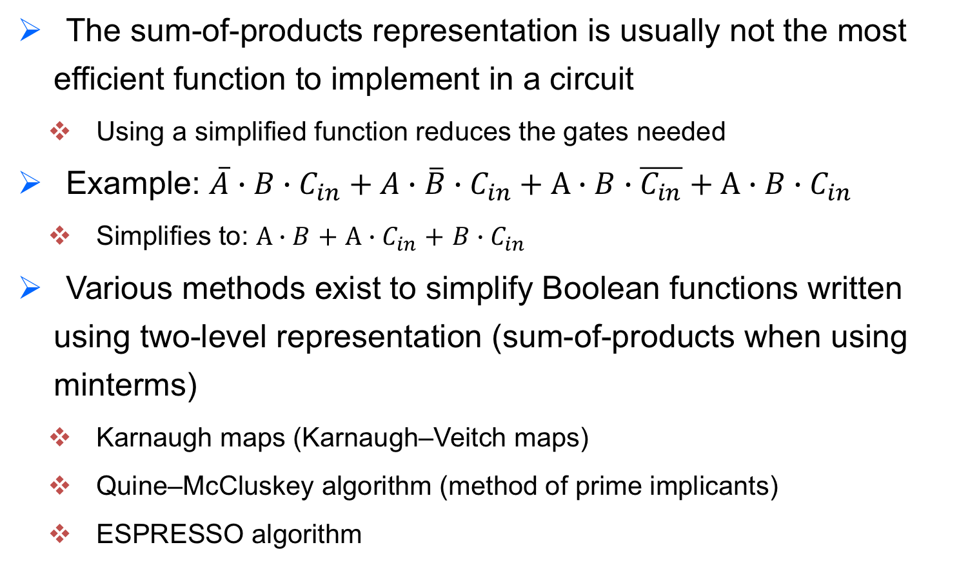
Simplification of Boolean Logic Functions
The sum-of-products representation is usually not the most efficient function to implement in a circuit
Using a simplified function reduces the gates needed
Example: $\overline{A}∙B∙C_{in}+A∙\overline{B}∙C_{in}+A∙B∙\overline{C_{in}}+A∙B∙C_{in}$
Simplifies to: $A∙B$ $+$ $A∙C_{in}$ $+$ $B∙C_{in}$
Various methods exist to simplify Boolean functions written using two-level representation (sum-of-products when using minterms)
Karnaugh maps (Karnaugh–Veitch maps)
Quine–McCluskey algorithm (method of prime implicants)
ESPRESSO algorithm

Slide 4
Karnaugh Maps
Results from the Boolean function (outputs) are arranged onto a 2-dimensional grid with each cell position representing a combination of input conditions (minterm)
input |  |  | output
A | B | C_{in} | C_{out}
0 | 0 | 0 | 0
0 | 0 | 1 | 0
0 | 1 | 0 | 0
0 | 1 | 1 | 1
1 | 0 | 0 | 0
1 | 0 | 1 | 1
1 | 1 | 0 | 1
1 | 1 | 1 | 1
 |  | AB
 |  | 00 | 01 | 11 | 10
C_{in} | 0 | 0 | 0 | 1 | 0
 | 1 | 0 | 1 | 1 | 1

Slide 5


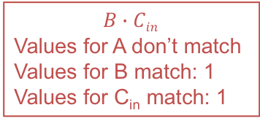
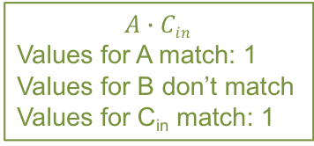
Karnaugh Maps
To form the simplified expression, using the Karnaugh map group together adjacent cells with a value of 1 in a rectangle of 2^{x} width and 2^{y} height maximizing x and y without including any cells with a value of 0
Repeat until all cells with 1 are in such a group, any isolated cells with 1 are grouped in a 1x1 rectangle
$$A∙B$$
Values for A match: 1
Values for B match: 1
Values for C_{in} don’t match
$$A∙Cin$$
Values for A match: 1
Values for B don’t match
Values for C_{in} match: 1
 |  | AB
 |  | 00 | 01 | 11 | 10
C_{in} | 0 | 0 | 0 | 1 | 0
 | 1 | 0 | 1 | 1 | 1
$$B∙Cin$$
Values for A don’t match
Values for B match: 1
Values for C_{in} match: 1
$A∙B$ $+$ $A∙C_{in}$ $+$ $B∙C_{in}$

Slide 6
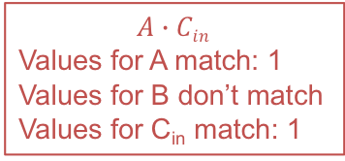
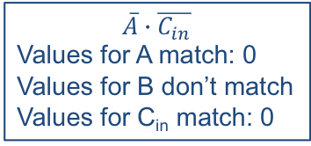

Karnaugh Maps
The resulting simplified expression will be the sum of each of the groups.
Each group corresponds to a product of all values of an input variable with a value of 1 corresponding to all grouped cells and the negated value of an input variable with a value of 0 corresponding to all grouped cells
$$\overline{A}∙\overline{C_{in}}$$
Values for A match: 0
Values for B don’t match
Values for C_{in} match: 0
$$A∙Cin$$
Values for A match: 1
Values for B don’t match
Values for C_{in} match: 1
 |  | AB
 |  | 00 | 01 | 11 | 10
C_{in} | 0 | 1 | 1 | 0 | 0
 | 1 | 0 | 0 | 1 | 1
$\overline{A}∙\overline{C_{in}}+$ $A∙Cin$

Slide 7
Administrivia
Exam 1 on Wednesday February 12
In class, same room and time
Time allowed: 75 minutes
No notes, no calculator, no textbook
You may bring a half letter size (approx. 8.5” x 5.5”) reference sheet with handwritten notes on one side

Slide 8
Exam 1
Format
Written exam, 11 - 13 questions (100 points) and 2 extra credit questions (+10 points)
Response types include short-answer/fill-in-the-blank (including selection), mathematical questions (formula / calculation, numbers used will be simple) and a few longer answer questions (truth tables, logic gate circuits, etc.)
Chapters covered:
Chapter 1: Technology, improvements in computer hardware, performance and benchmarking (Lectures 1 – 4)
Appendix B: Combinational logic, adders, sequential logic, finite state machines and counters (Lectures 5 – 8)
Not in textbook (limited to extra credit): Karnaugh maps

Slide 9
Outline of Topics
Lecture 1 – Introduction
Progress in computer technology, Moore’s law, Dennard Scaling
Types of computers
Hardware vs. software
High level language vs assembly vs. machine language
Lecture 2 – Technology, Performance and Power
Orders of magnitude (giga / nano, etc.)
Response time vs. throughput
Relative performance / speedup
Measuring execution time

Slide 10
Outline of Topics
Lecture 3 – Technology, Performance and Power II
Elapsed time vs. CPU time
CPU clock cycle
CPU Performance equation (instruction count, cycles per instruction, seconds per cycle), possible influencing factors
Amdahl’s law and overall speedup
Comparison of performance using clock rate, CPI and IC
Lecture 4 – Benchmarking
Power usage (capacitive load, voltage, frequency)
Methods (real programs / modified apps / kernels / synthetic benchmarks (i.e. whetstone), benchmarking suites
Comparing benchmarks using arithmetic mean vs. normalized geometric mean

Slide 11
Outline of Topics
Lecture 5 – Combinational Logic
Logic gates and functions (AND, OR, NOT, etc.)
Boolean algebra (laws of, DeMorgan’s Theorem)
Truth tables, logic functions and two-level representation (sum of products)
Logic gate circuit diagrams
Lecture 6 – Adders
Multiplexers
Half adder and full adder
Carry-lookahead adders, using “generate” and “propagate” to calculate carry values
Performance of a ripple adder vs. a carry-lookahead adder

Slide 12
Outline of Topics
Lecture 7 – Sequential Logic
Arithmetic Logic Unit
Circuits with a state (“memory”), memory cells, feedback circuits
S-R Latch, D Latch, Edge-triggered D Flip-Flop
Latches vs. flip-flops
Register file
Lecture 8 – Counters and Finite State Machines
State machine model: inputs, states, transition (to another state) and output
State diagrams and state transition tables
Circuit design of state machines (using D flip-flops for state bits)
Counters

Slide 13
Outline of Topics
Lecture 8½ – Karnaugh Maps and Review (not in the textbook)
Simplification of sum of products Boolean function
Converting a truth table to a Karnaugh map
Grouping cells with a ‘1’ value to form a product term
Simplified function is the sum of the product terms for each group

